Slide 1

Strategy vs. Plan
Understanding the role and differences of these tools when creating your fundraising goals
Presented by Kimberly Perron, MBA
Customer Success Instructor

Slide 2










Slide 3
Steps to Fundraising Success
Success!
Review
Actions
Objectives
Strategy
Vision

Slide 4

Strategy vs Plan
Action
Strategy
Plan

Slide 5
STRATEGY
Long-term view 3 – 5 years
Incorporates vision, values, and mission
Examines internal and external factors
Attempts to determine “why”
Creates major objectives to help achieve vision

Slide 6
ACTION PLAN
Short-term view - 1 year max
Create steps to achieve goals
Assigns responsibilities
Due dates
Measure progress
Ensures resources are distributed evenly

Slide 7
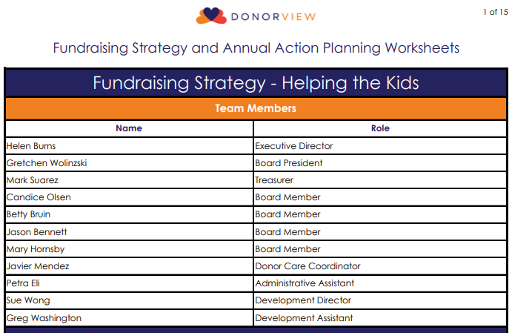
STRATEGY – Team Members
Executive team
Fundraising team
Board of Directors
Other key stakeholders

Slide 8
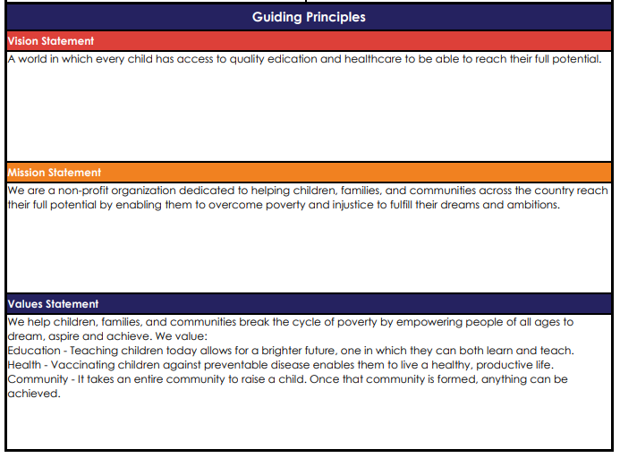
STRATEGY – Guiding Principles
Vision
Mission
Values

Slide 9
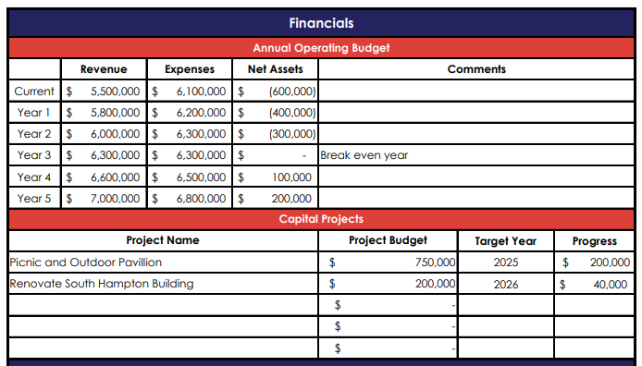
STRATEGY – Financial Situation
Operating Budget
Capital Projects
Complete after SWOT & priorities

Slide 10
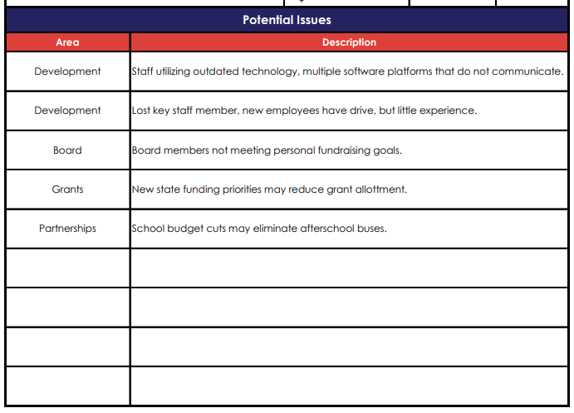
STRATEGY – Potential Issues
Can identify known issues
Stay focused on fundraising
Be sure to include in SWOT Analysis

Slide 11
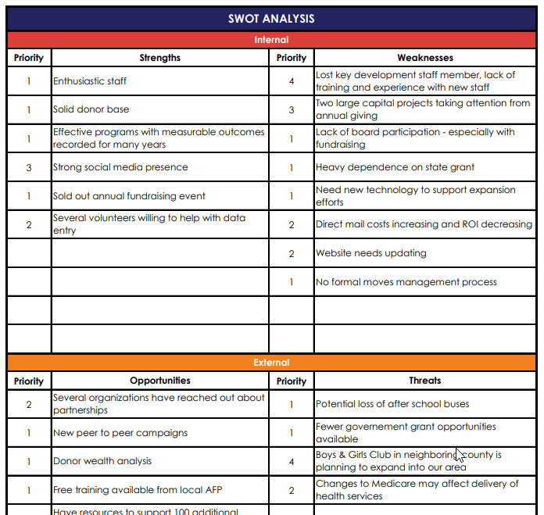
STRATEGY – SWOT Analysis
Internal
Strengths
Weaknesses
External
Opportunities
Threats

Slide 12
STRATEGY – SWOT: Strengths
Review your fundraising processes
Workflows
Good KPIs
What are you doing well
Extra resources
Skills & experience

Slide 13
STRATEGY – SWOT: Weaknesses
Identified internal issues
Poor Workflows
Unsatisfactory KPIs
Lack of technology/resources
Training
Staffing

Slide 14
STRATEGY – SWOT: Opportunities
Trends
Funding sources
Partnerships
Technology
Prospect research
Services

Slide 15
STRATEGY – SWOT: Threats
Competition
Vulnerabilities
Negative trends – politics/economy
Government regulations
Donor/volunteer loss

Slide 16
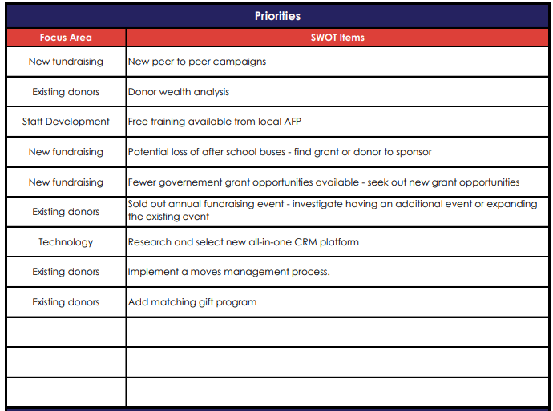
STRATEGY – SWOT: Prioritize
Prioritize
Get stakeholder’s
input
Validate with guiding principles

Slide 17
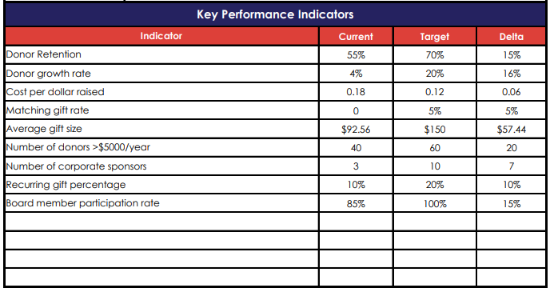
STRATEGY – Key Performance Indicators
Mix of KPIs
Leading
Lagging
Track with CRM
Validate with guiding principles

Slide 18
STRATEGY – Analysis
To be address in next webinar:
Root cause analysis
Find the “why’s”
Evaluating options

Slide 19
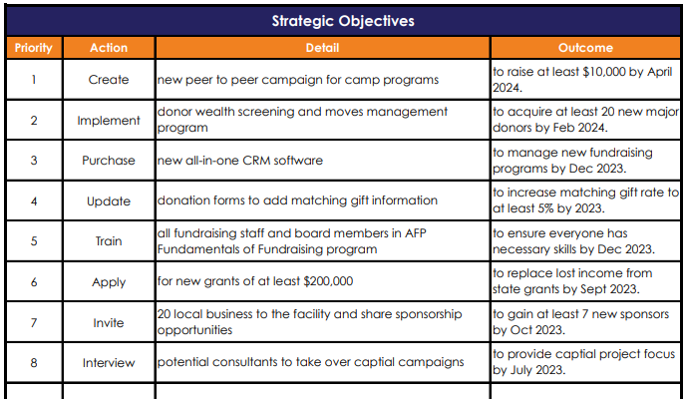
STRATEGY – Strategic Objectives
Create an objective for each priority
Verb + Activity + Measurable Outcome
Connects to Action Plan

Slide 20
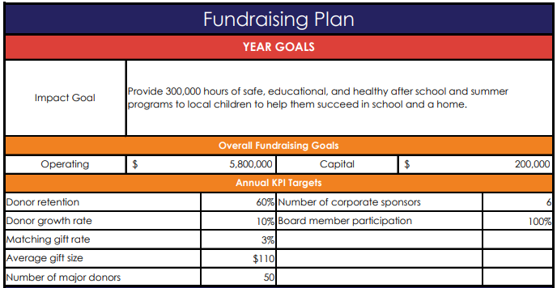
ACTION PLAN – Annual Goals
Impact Goal
Financial Goals
Target KPIs

Slide 21
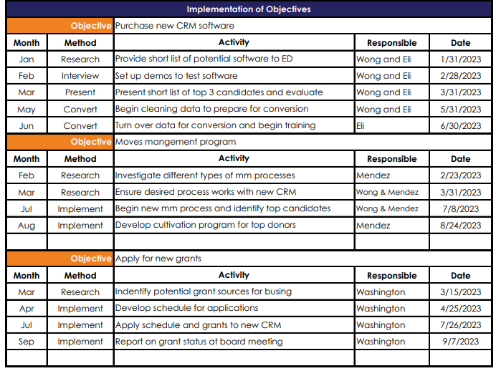
ACTION PLAN – Implement Objectives
Add action steps for each objective
Month
Method
Activities
Responsibility
Due Date

Slide 22
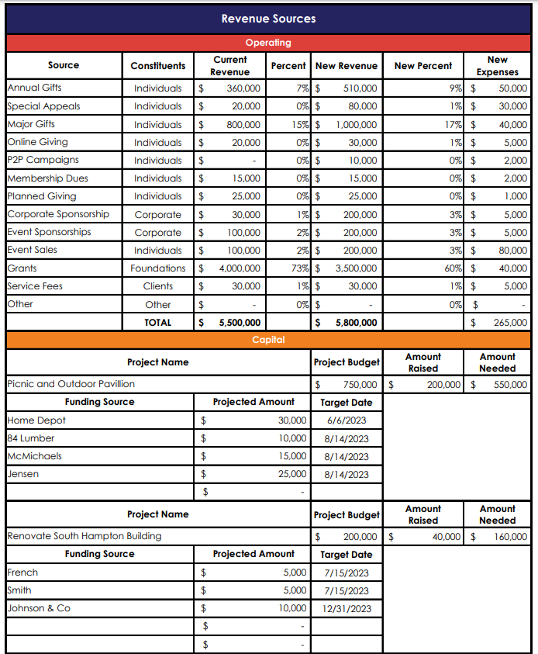
ACTION PLAN – Revenue Sources
Operating
Current Revenue
Projected Revenue
Percentages
Expenses
Capital Projects

Slide 23
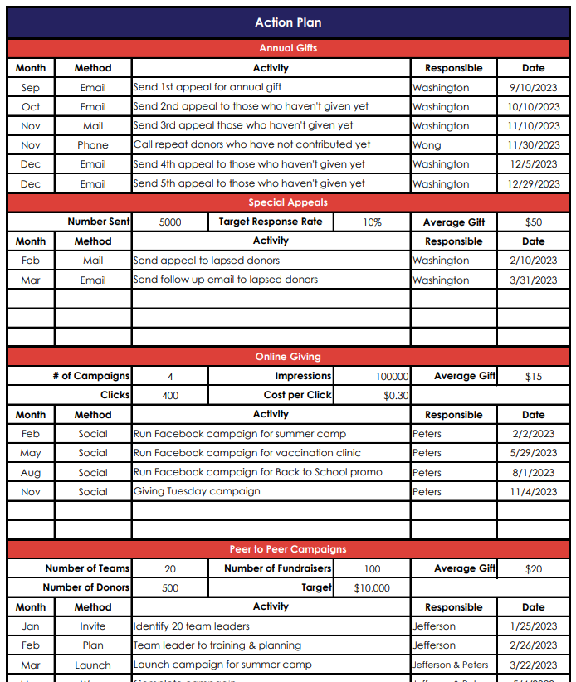
ACTION PLAN – Revenue Actions
Identify milestone activities for each revenue source
Can include KPIs

Slide 24
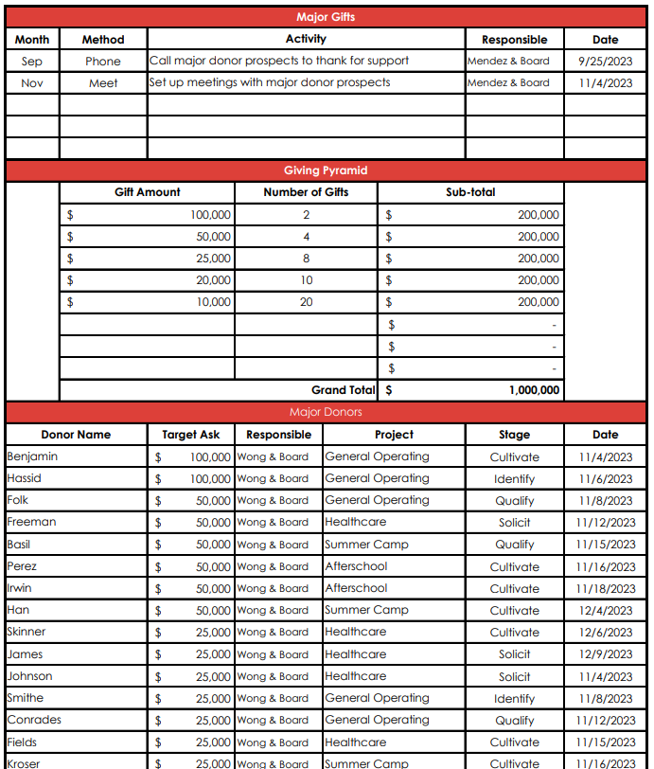
ACTION PLAN – Major Gifts/Sponsors/Grants
Proposals
Moves management
Get specific

Slide 25
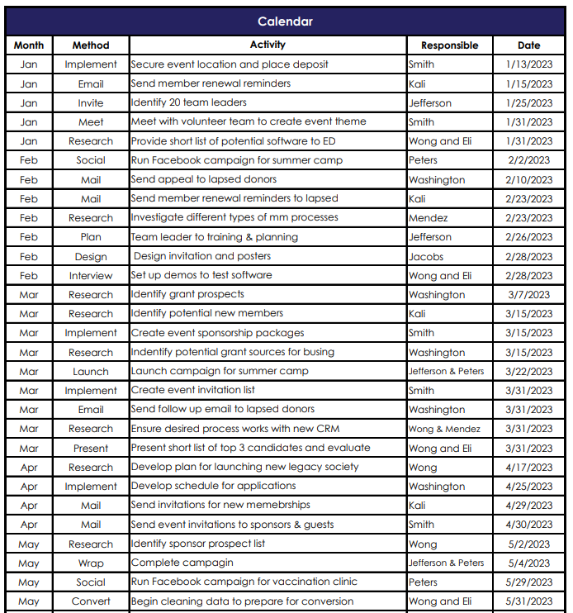
ACTION PLAN – Calendar
From action plans
Add details
Communications
Meetings
Reports
Distribute resources

Slide 26
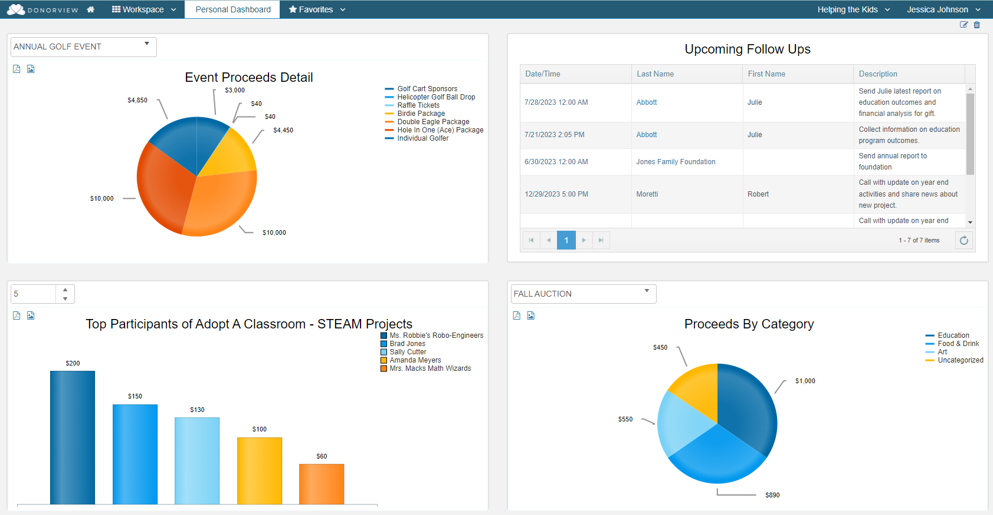
ACTION PLAN – CRM Software
Track activities
Plan contacts
Calculate KPIs
Communications
Reports

Slide 27
Watch the video and download the free Excel worksheet Donorview.com/AFPwebinar Register for next webinar on July 11th Strategy Planning Deep Dive
Next Steps

Slide 28

THANK YOU!
Request a Demo
Scan to visit our website and set up a free demo!
DonorView.com/Demo
Contact Us:
508-205-0243
sales@donorview.com
donorview.com

